Slide 1
Adversarial Search
Minmax, Alpha Beta, Monte Carlo Tree Search

Slide 2
Monte Carlo tree Search
It is a powerful algorithm used primarily for decision-making in AI, especially in scenarios where you need to make decisions over a sequence of actions (i.e., planning problems). MCTS is used in a variety of domains, particularly in games and planning problems.
For adversarial environments (e.g. games)It uses random simulations to explore potential moves and outcomes, making it highly effective for problems with large or complex search spaces.

Slide 3
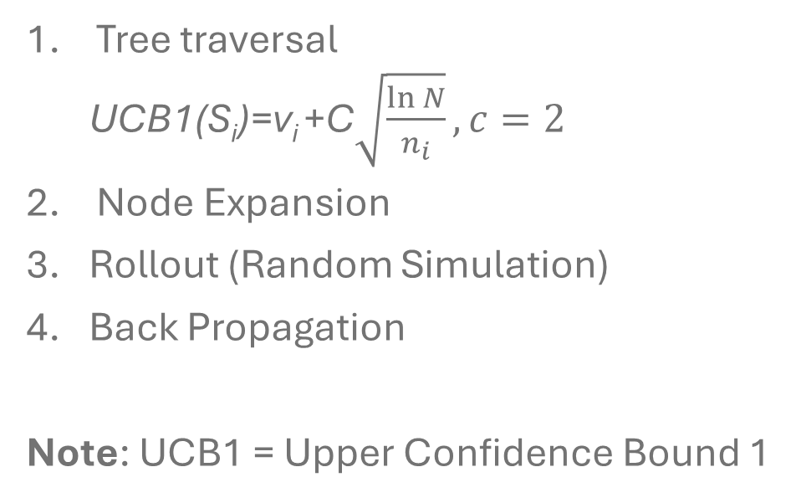
Monte Carlo tree Search
Tree traversal
  UCB1(S_{i})=v_{i} +C$\sqrt{\frac{\ln{N}}{n_{i}}}, c=2$
Node Expansion
Rollout (Random Simulation)
Back Propagation
Note: UCB1 = Upper Confidence Bound 1

Slide 4
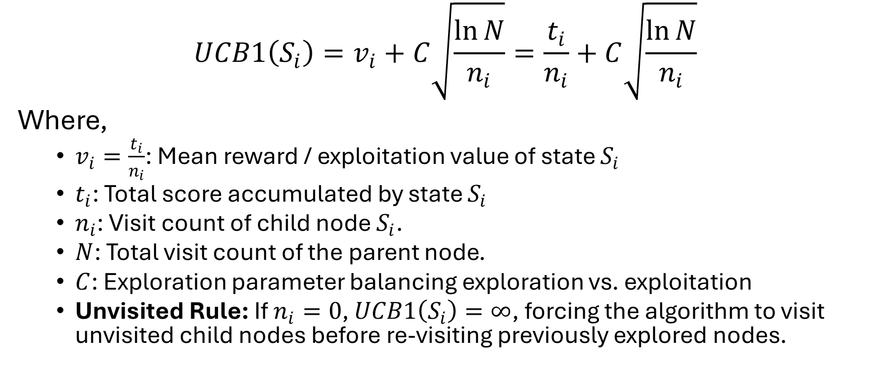
Upper Confidence Bound
$$UCB1\left(S_{i}\right)=v_{i}+C\sqrt{\frac{\ln{N}}{n_{i}}}=\frac{t_{i}}{n_{i}}+C\sqrt{\frac{\ln{N}}{n_{i}}}$$
Where,
  $v_{i}=\frac{t_{i}}{n_{i}}$: Mean reward / exploitation value of state $S_{i}$
  $t_{i}$: Total score accumulated by state $S_{i}$
  $n_{i}$: Visit count of child node $S_{i}$.
  $N$: Total visit count of the parent node.
  $C$: Exploration parameter balancing exploration vs. exploitation
  Unvisited Rule: If $n_{i}=0$, $UCB1\left(S_{i}\right)=∞$, forcing the algorithm to visit unvisited child nodes before re-visiting previously explored nodes.

Slide 5
Monte Carlo tree Search
Start
Algorithm for Tree
Traversal and Node Expancsion
Current=S₀
Is current a leaf node?
Is the n_{i} value for current 0?
yes
yes
ROLLOUT
No
No
Current=child node of current that maximizes UCB1(S_{i})
For each available action for current, add a new state to the tree
Current=first new child node

Slide 6
Monte Carlo tree Search
Rollout(S_{i})
loop forever
if S_{i} is a terminal state:
return value (S_{i})
Ai=random (available actions(S_{i}))
S_{i}=simulate(A_{i},S_{i})
S_{i}
terminal state

Slide 7
Monte Carlo tree Search
S₀
Add in the available actions from S₀ that is S₁ from action a1 and S₂ from action a2

Slide 8
Monte Carlo tree Search
Which one to visit first?
Calculate the UCB value for both states
_{Both are infinite}
_{So select one of them randomly}
S₀
t₀=0
n₀=0
a1
a2
S₁
t₁=0
n₁=0
S₂
t₂=0
n₂=0

Slide 9
Monte Carlo tree Search
Lets say you select S1
S1 is a leaf node?
Yes
n_{i} =0?
Yes
ROLLOUT!
S₀
t₀=0
n₀=0
a1
a2
S₁
t₁=0
n₁=0
S₂
t₂=0
n₂=0

Slide 10
Monte Carlo tree Search
S₀
t₀=0
n₀=0
a1
a2
S₁
t₁=0
n₁=0
S₂
t₂=0
n₂=0
terminal state
v=20

Slide 11
Monte Carlo tree Search
backpropagate
S₀
t₀=20
n₀=1
a1
a2
S₁
t₁=20
n₁=1
S₂
t₂=0
n₂=0

Slide 12
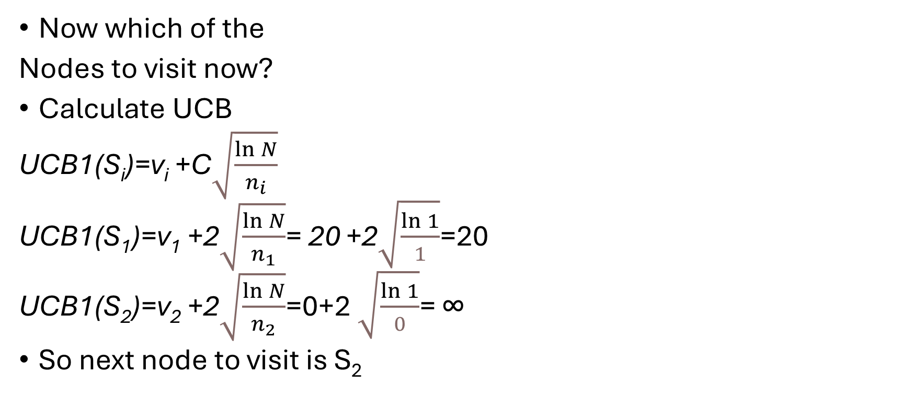
Monte Carlo tree Search
Now which of the
Nodes to visit now?
Calculate UCB
UCB1(S_{i})=v_{i} +C$\sqrt{\frac{\ln{N}}{n_{i}}}$
UCB1(S₁)=v₁ +2$\sqrt{\frac{\ln{N}}{n_{1}}}$= 20 +2$\sqrt{\frac{\ln{1}}{1}}$=20
UCB1(S₂)=v₂ +2$\sqrt{\frac{\ln{N}}{n_{2}}}$=0+2 $\sqrt{\frac{\ln{1}}{0}}$= ∞
So next node to visit is S₂
S₀
t₀=20
n₀=1
a1
a2
S₁
t₁=20
n₁=1
S₂
t₂=0
n₂=0

Slide 13
Monte Carlo tree Search
S2 is a leaf node?
Yes
n₂ =0?
Yes
ROLLOUT!
S₀
t₀=20
n₀=1
a1
a2
S₁
t₁=20
n₁=1
S₂
t₂=0
n₂=0

Slide 14
Monte Carlo tree Search
ROLLOUT!
S₀
t₀=20
n₀=1
a1
a2
S₁
t₁=20
n₁=1
S₂
t₂=0
n₂=0
terminal state
v=10

Slide 15
Monte Carlo tree Search
Back propagate
S₀
t₀=20+10=30
n₀=1+1=2
a1
a2
S₁
t₁=20
n₁=1
S₂
t₂=10
n₂=1

Slide 16
So far, two iterations are completed

Slide 17
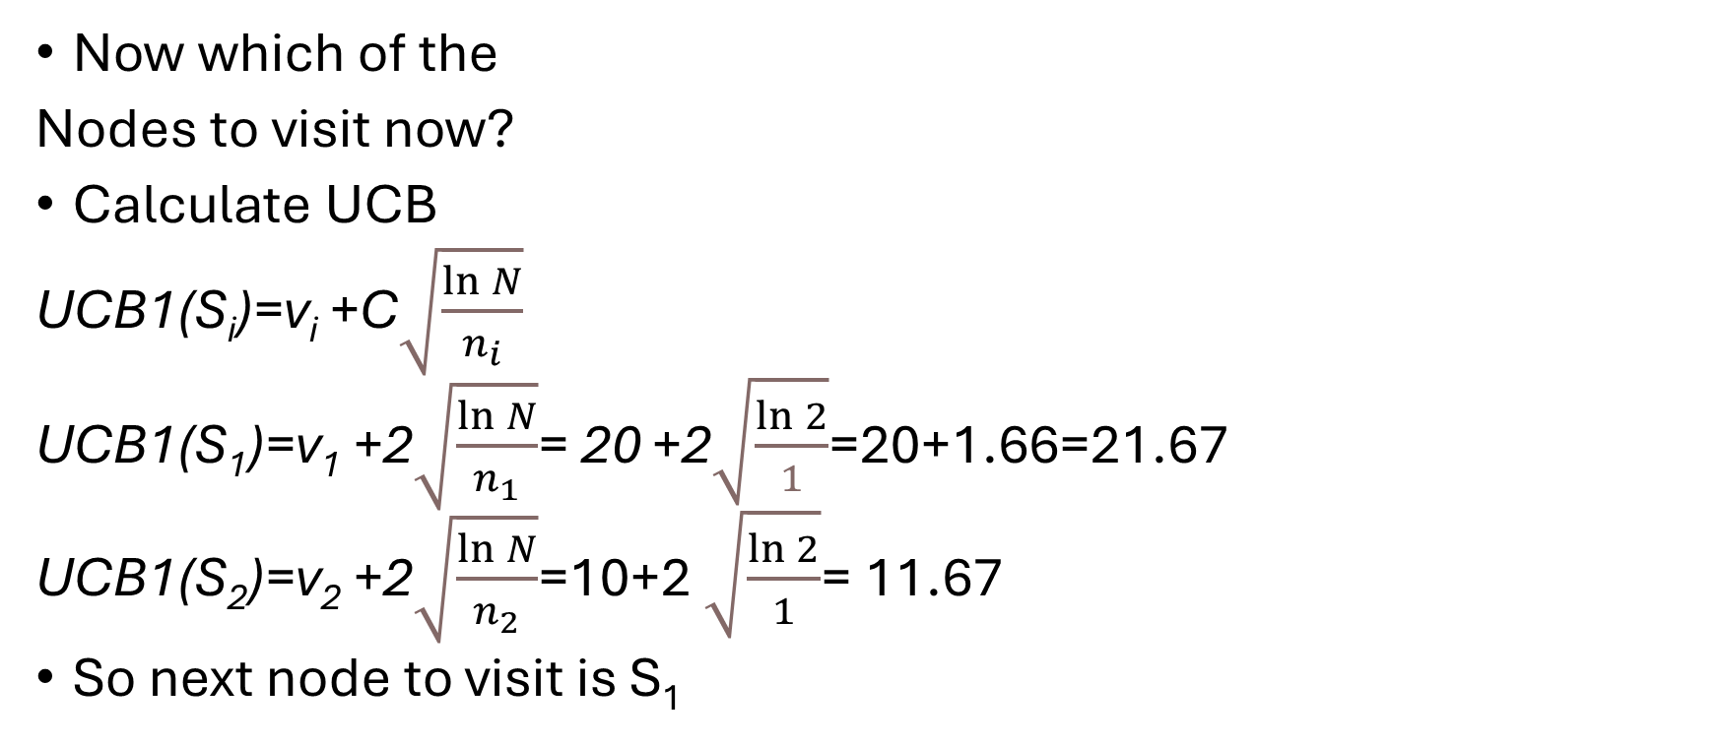
Monte Carlo tree Search
Now which of the
Nodes to visit now?
Calculate UCB
UCB1(S_{i})=v_{i} +C$\sqrt{\frac{\ln{N}}{n_{i}}}$
UCB1(S₁)=v₁ +2$\sqrt{\frac{\ln{N}}{n_{1}}}$= 20 +2$\sqrt{\frac{\ln{2}}{1}}$=20+1.66=21.67
UCB1(S₂)=v₂ +2$\sqrt{\frac{\ln{N}}{n_{2}}}$=10+2 $\sqrt{\frac{\ln{2}}{1}}$= 11.67
So next node to visit is S₁
S₀
t₀=20+10=30
n₀=1+1=2
a1
a2
S₁
t₁=20
n₁=1
S₂
t₂=10
n₂=1

Slide 18
Monte Carlo tree Search
S1 is a leaf node?
Yes
n_{i} =0?
No
For each available
action for current,
add a new state
to the tree
S₀
t₀=20+10=30
n₀=1+1=2
a1
a2
S₁
t₁=20
n₁=1
S₂
t₂=10
n₂=1
a1
a2
S₃
t₃=0
n₃=0
S₄
t₄=0
n₄=0

Slide 19
Monte Carlo tree Search
S3 or s4?
Since both have same UCB1 score i.e., ∞
chose randomly
Lets chose S3
S₀
t₀=20+10=30
n₀=1+1=2
a1
a2
S₁
t₁=20
n₁=1
S₂
t₂=10
n₂=1
a3
a4
S₃
t₃=0
n₃=0
S₄
t₄=0
n₄=0

Slide 20
Monte Carlo tree Search
S3 is a leaf node?
Yes
n_{i} =0?
yes
ROLLOUT
S₀
t₀=20+10=30
n₀=1+1=2
a1
a2
S₁
t₁=20
n₁=1
S₂
t₂=10
n₂=1
a3
a4
S₃
t₃=0
n₃=0
S₄
t₄=0
n₄=0
terminal state
v=0

Slide 21
Monte Carlo tree Search
Back propagate
S₀
t₀=20+10+0=30
n₀=1+1+1=3
a1
a2
S₁
t₁=20
n₁=1+1
S₂
t₂=10
n₂=1
a3
a4
S₃
t₃=0
n₃=1
S₄
t₄=0
n₄=0

Slide 22
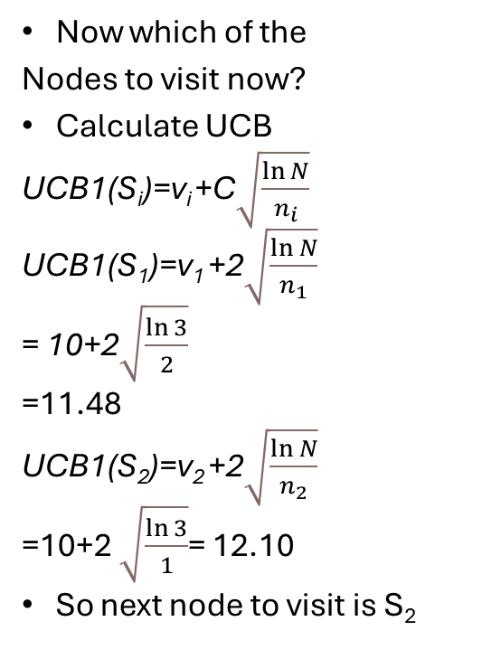
Monte Carlo tree Search
Now which of the
Nodes to visit now?
Calculate UCB
UCB1(S_{i})=v_{i} +C$\sqrt{\frac{\ln{N}}{n_{i}}}$
UCB1(S₁)=v₁ +2$\sqrt{\frac{\ln{N}}{n_{1}}}$
= 10+2$\sqrt{\frac{\ln{3}}{2}}$
=11.48
UCB1(S₂)=v₂ +2$\sqrt{\frac{\ln{N}}{n_{2}}}$
=10+2 $\sqrt{\frac{\ln{3}}{1}}$= 12.10
So next node to visit is S₂
S₀
t₀=20+10+0=30
n₀=1+1+1=3
a1
a2
S₁
t₁=20
n₁=1+1
S₂
t₂=10
n₂=1
a3
a4
S₃
t₃=0
n₃=1
S₄
t₄=0
n₄=0

Slide 23
Monte Carlo tree Search
S2 is a leaf node?
Yes
n₂ =0?
No
S₀
t₀=20+10+0=30
n₀=1+1+1=3
a1
a2
S₁
t₁=20
n₁=1+1
S₂
t₂=10
n₂=1
a3
a4
S₃
t₃=0
n₃=1
S₄
t₄=0
n₄=0

Slide 24
Monte Carlo tree Search
For each available
action for S₂,
add a new state
to the tree
S₀
t₀=20+10+0=30
n₀=1+1+1=3
a1
a2
S₁
t₁=20
n₁=1+1
S₂
t₂=10
n₂=1
a3
a4
S₃
t₃=0
n₃=1
S₄
t₄=0
n₄=0
a5
a6
S₅
S₆
t₅=0
n₅=0
t₆=0
n₆=0

Slide 25
Monte Carlo tree Search
S5 or S6 first?
Both have same UCB1 i.e., ∞
So select randomly
Lets select S₆
S₀
t₀=20+10+0=30
n₀=1+1+1=3
a1
a2
S₁
t₁=20
n₁=1+1
S₂
t₂=10
n₂=1
a3
a4
S₃
t₃=0
n₃=1
S₄
t₄=0
n₄=0
a5
a6
S₅
S₆
t₅=0
n₅=0
t₆=0
n₆=0

Slide 26
Monte Carlo tree Search
S6 is a leaf node?
Yes
n₆ =0?
Yes
ROLLOUT!
S₀
t₀=20+10+0=30
n₀=1+1+1=3
a1
a2
S₁
t₁=20
n₁=1+1
S₂
t₂=10
n₂=1
a3
a4
S₃
t₃=0
n₃=1
S₄
t₄=0
n₄=0
a5
a6
S₅
S₆
t₅=0
n₅=0
t₆=0
n₆=0
terminal state
v=14

Slide 27
Monte Carlo tree Search
Back propagate
S₀
t₀=20+10+0+14=44
n₀=1+1+1+1=4
a1
a2
S₁
t₁=20
n₁=1+1
S₂
t₂=24
n₂=2
a3
a4
S₃
t₃=0
n₃=1
S₄
t₄=0
n₄=0
a5
a6
S₅
S₆
t₅=0
n₅=0
t₆=14
n₆=1

Slide 28
4 iterations have been completed
Do 4 more iterations for understanding and the algorithm behaviour

